Slide 1
Stack

Slide 2
Stack
Stacks in real life: stack of books, stack of plates
Add new items at the top
Remove an item at the top
Stack data structure similar to real life: collection of elements arranged in a linear order.
Can only access element at the top

Slide 3
The Push & Pop Operations
A stack is an ordered collection of items into which new items may be inserted and from which items may be deleted at one end only, called top of the stack. i.e. deletion/insertion can only be done from top of the stack.
The insert operation on a stack is often called Push operation and delete operation is called Pop operation.

Slide 4
Example
D
Top of the Stack
C
B
A
NULL

Slide 5
Stack
In a stack, the element deleted from the list is the one most recently inserted.
Stack is also referred as Last-in First-out i.e LIFO.
The example of stack is the stacks of plates used in cafeterias. The order in which plates are popped from the stack is the reverse of the order in which they were pushed onto the stack, since only the top plate is accessible.

Slide 6
Overflow & Underflow
If an empty stack is popped, we say stack underflows, which is normally an error. and
If top of the stack exceeds n, the stack overflows.

Slide 7
Stack Operations
Push(X) – insert X as the top element of the stack
Pop() – remove the top element of the stack and return it.
Top() – return the top element without removing it from the stack.

Slide 8
Stack Operations
The last element to go into the stack is the first to come out: LIFO – Last In First Out.
What happens if we call pop() and there is no element?
Have IsEmpty() boolean function that returns true if stack is empty, false otherwise.
Throw StackEmpty exception.

Slide 9
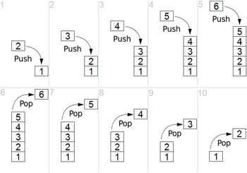
Example

Slide 10
thanks

